Slide 1
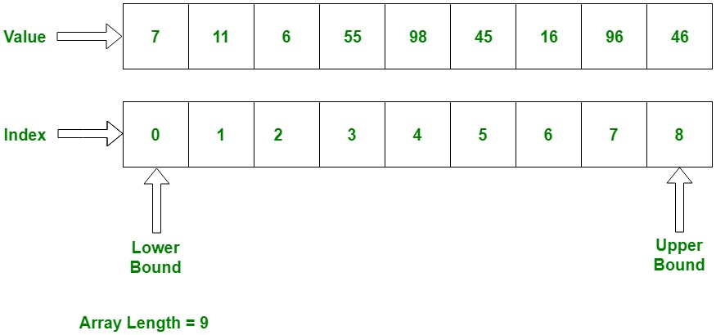
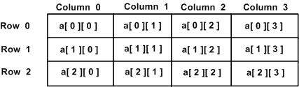
Data Structures: Arrays
1d array is used to store a list of data of a single datatype They are 0 based g
2s arrays are grids that store values They are 0 based Values must be off the same data type To find the values you go across then down

Slide 2
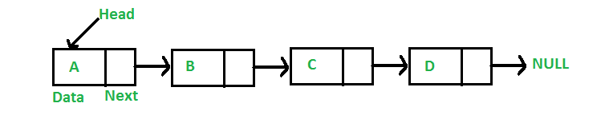
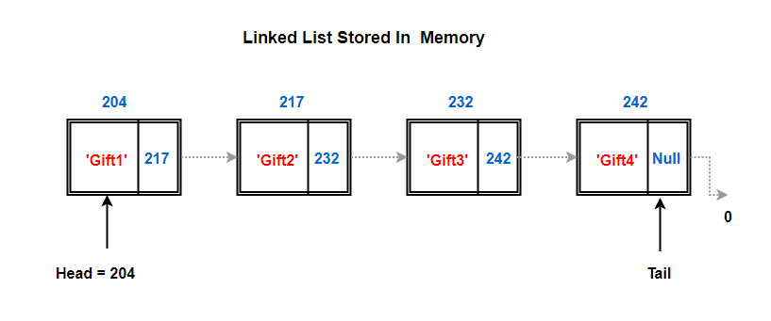
Data Structures: Lists/Linked Lists
Stores list of data that is ordered in some way Has a header to store the start of the list, and a pointer that points to the next value in the list To add data you have to move the pointers so it is very easy to do

Slide 3
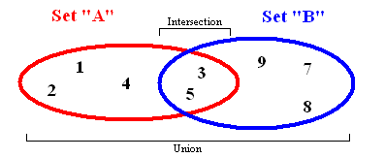
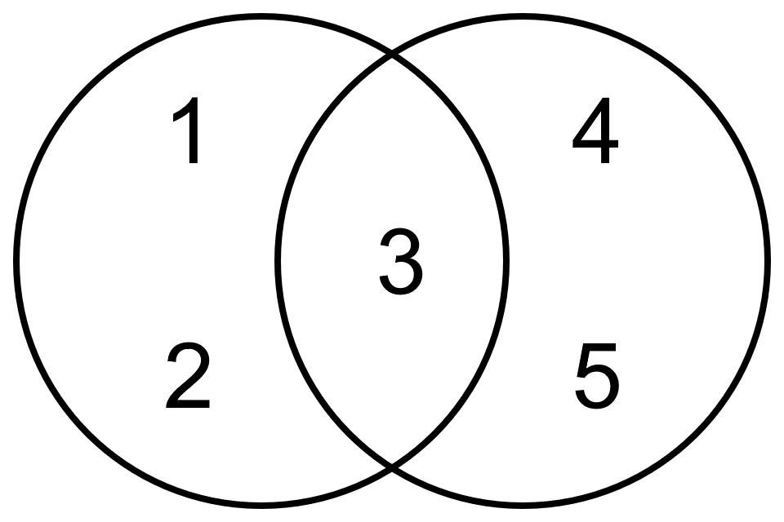
Data Structures: Sets
Used to store data Doesn’t need to have an exclusive datatype Cannot be duplicate data values in a set
Venn diagram

Slide 4
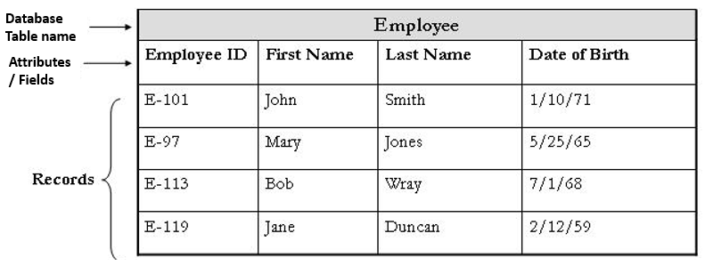
Data Structures: Records
Used in databases Similar to 2d arrays as it uses a table Always has a table name First row will have fields for each column Each column will have one type of data Can efficiently store a lot of data

Slide 5
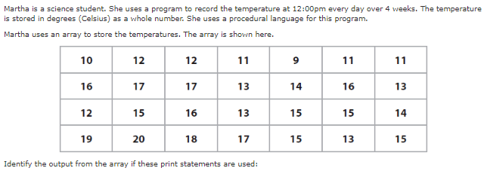
Bronze 1
Exam Questions
Assume the array is 0 based. Write below [1 mark]
17
Assume the array is 0 based. Write below [1 mark]
15

Slide 6
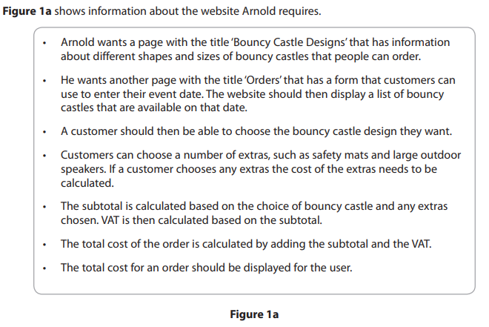
Silver 1
Exam Questions

Slide 7
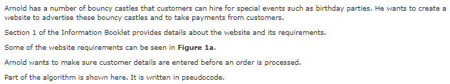
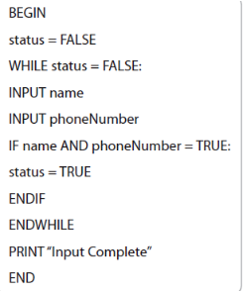
Silver 1
Exam Questions
Write below [3 mark]
Because there is not a range of numbers instead the value for the loop condition is a Boolean.

Slide 8
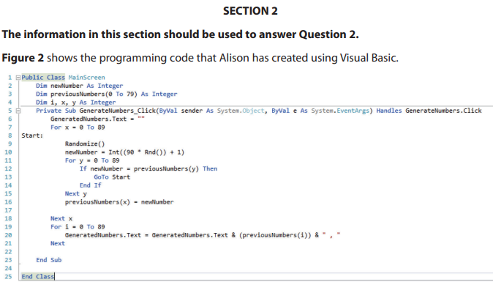
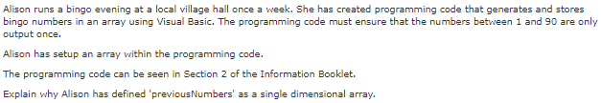
Silver 2
Exam Questions
Write below [3 mark]
Is more efficient than having it stored separately because they are all the same data type. It is also easier to check the numbersd that are used.

Slide 9
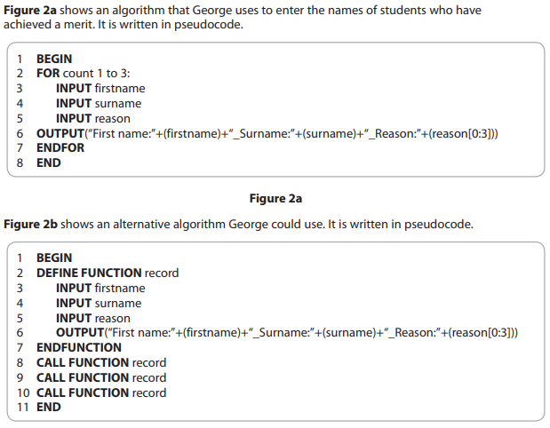
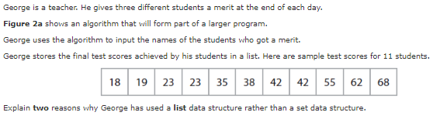
Silver 3
Exam Questions
Write below [4 mark]
A lis can be sorted but a set cannot maintain any order. Lists are dynamic whereas sets are static.

Slide 10
Gold 1
Exam Questions

